Slide 1
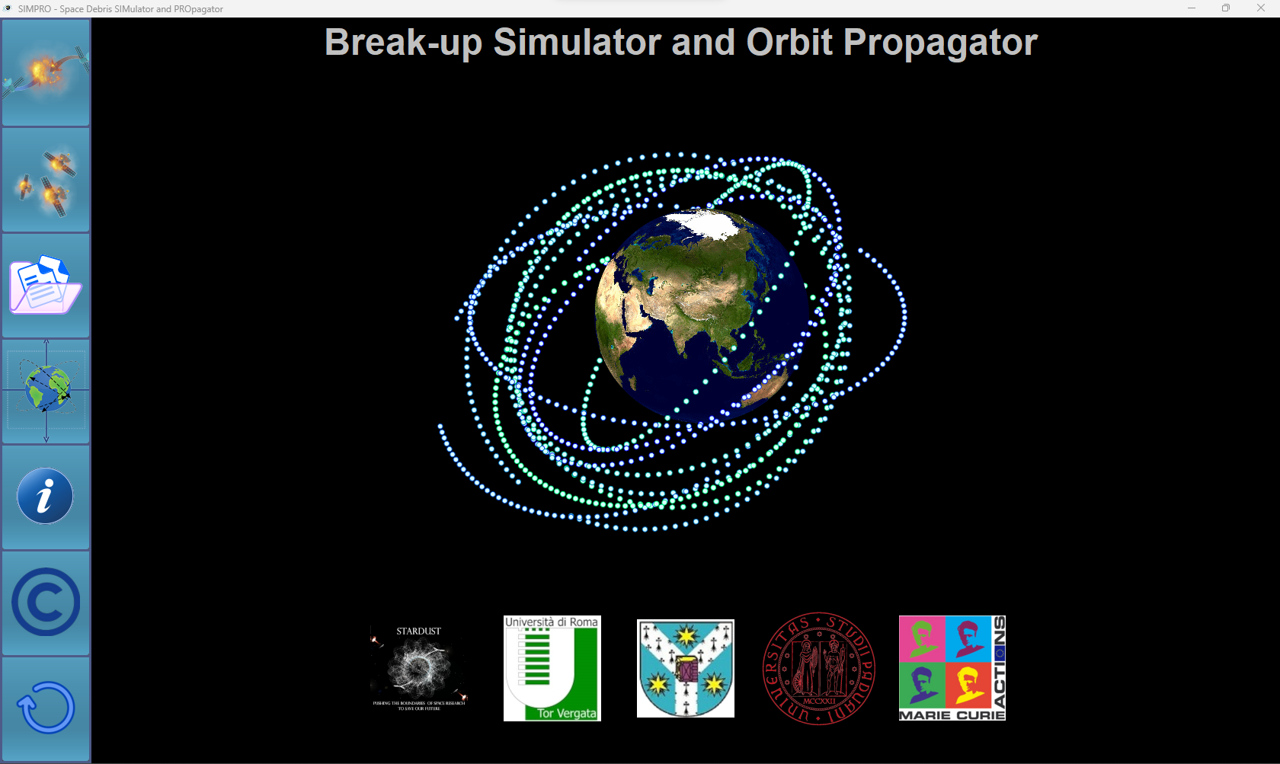
SIMPRO is a useful application for analyzing and controlling the space debris problem. For more details, please refer to the related article. The next slides contain a tutorial on how to use the application.
University Al. I. Cuza, Iași, Romania
Dr. Marius Apetrii
Prof. Cătălin Galeș
Dr. Tudor Vartolomei
University of Rome Tor Vergata, Italy
Prof. Alessandra Celletti
University of Padova, Italy
Prof. Christos Efthymiopoulos
H2020-MSCA-ITN-2018
(Marie Skłodowska-Curie Innovative Training Networks)
Stardust – R
project

Slide 2

Simulate a break-up event
Simulate multiple break-up events
View previous experiments
Propagate single orbit
User guide
Authorship
Reset application

Slide 3
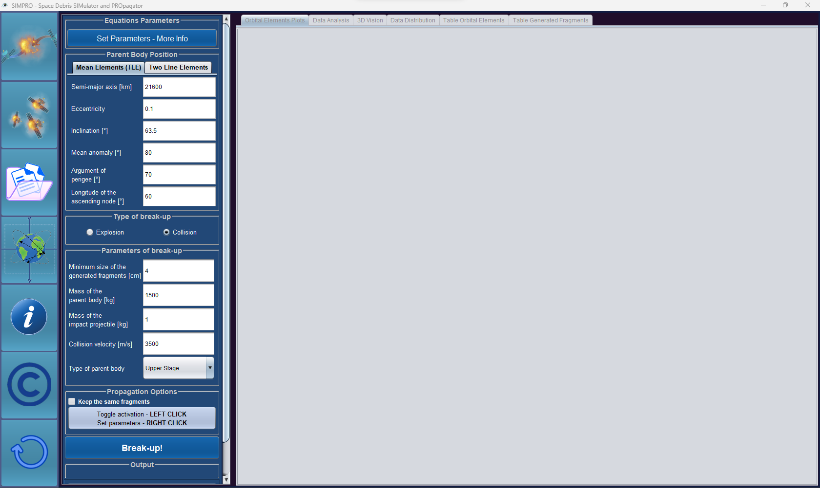
Set orbital elements of the parent body
Choose between explosion and collision
Parameters for collision break-up
Run the experiment

Slide 4
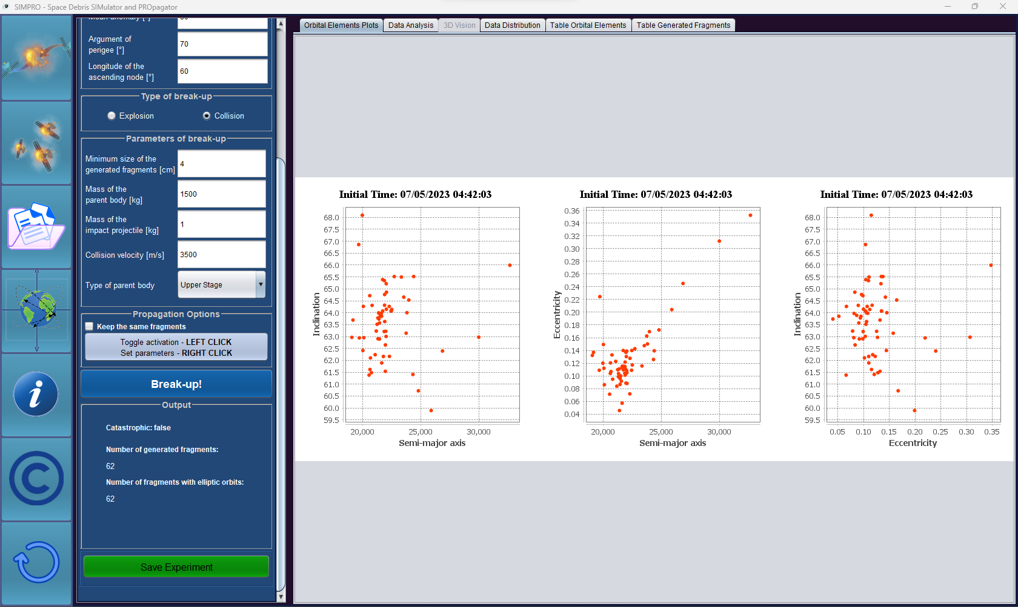
Panel containing plots of the orbital position elements: semi-major axis, eccentricity, inclination
Information about the current event

Slide 5
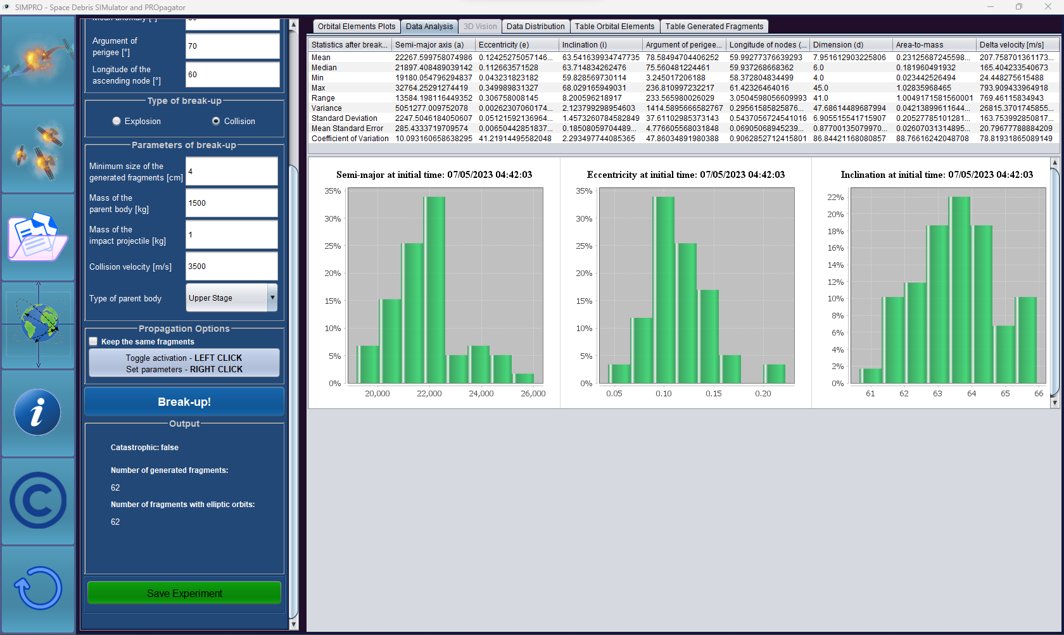
Panel containing statistics about the orbital elements and fragments’ parameters and histograms of the orbital position elements: semi-major axis, eccentricity, inclination
Common statistics of the fragments’ parameters

Slide 6
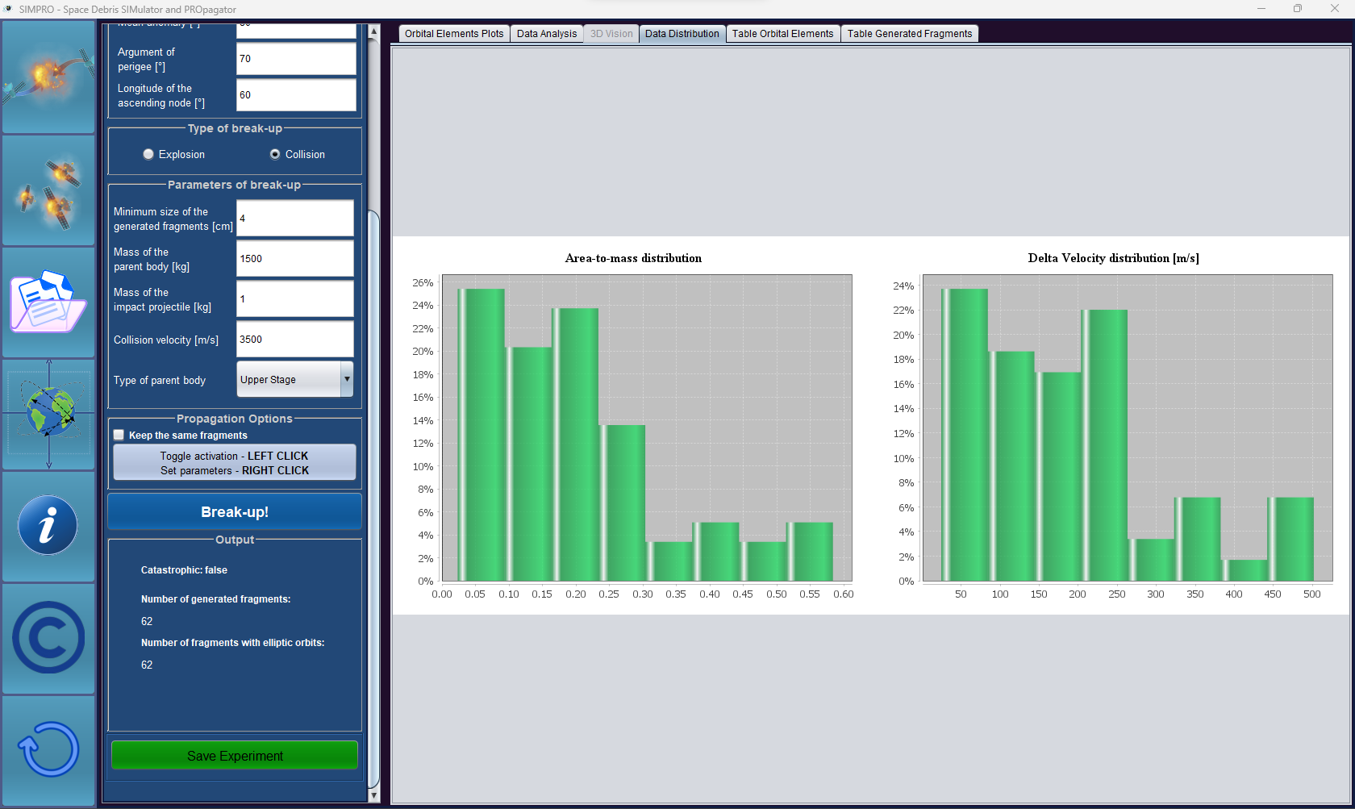
Distribution of fragments’ size, area-to-mass and delta velocity. Distribution of orbital elements w.r.t. dimension

Slide 7
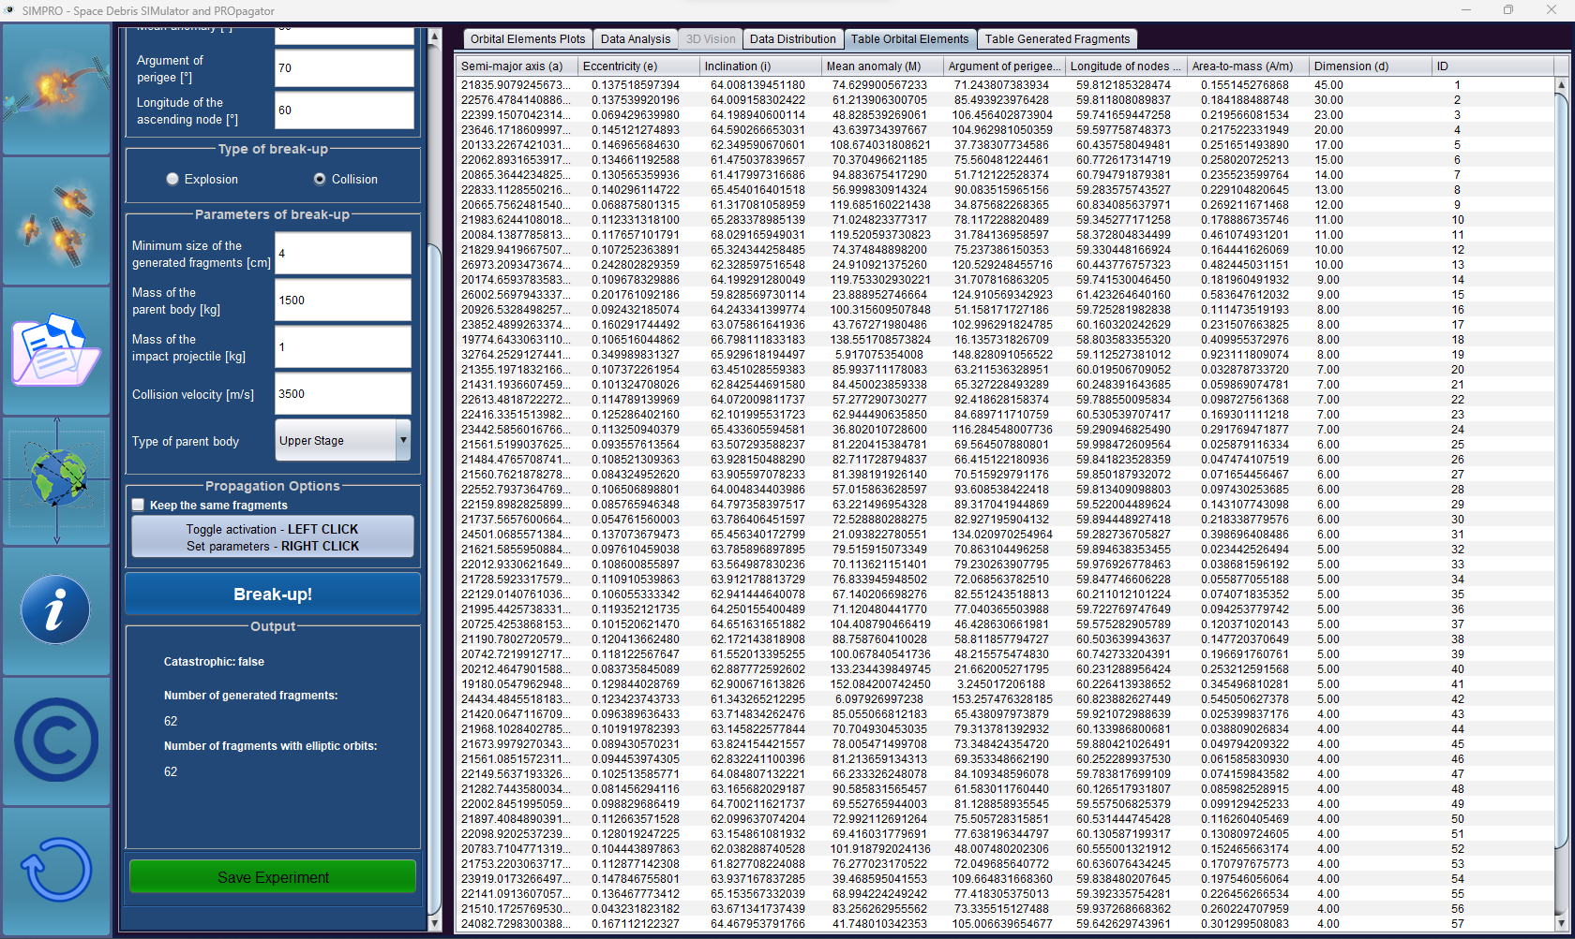
Panel containing the table with the orbital position of each generated fragment

Slide 8
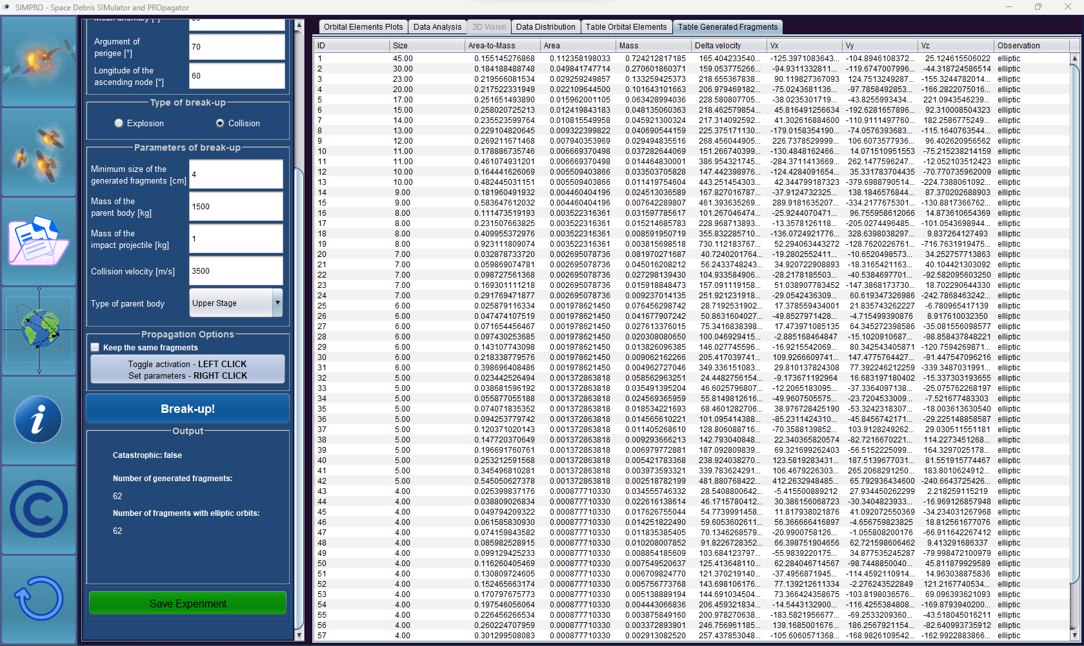
Panel containing the table with the parameters of each generated fragment

Slide 9
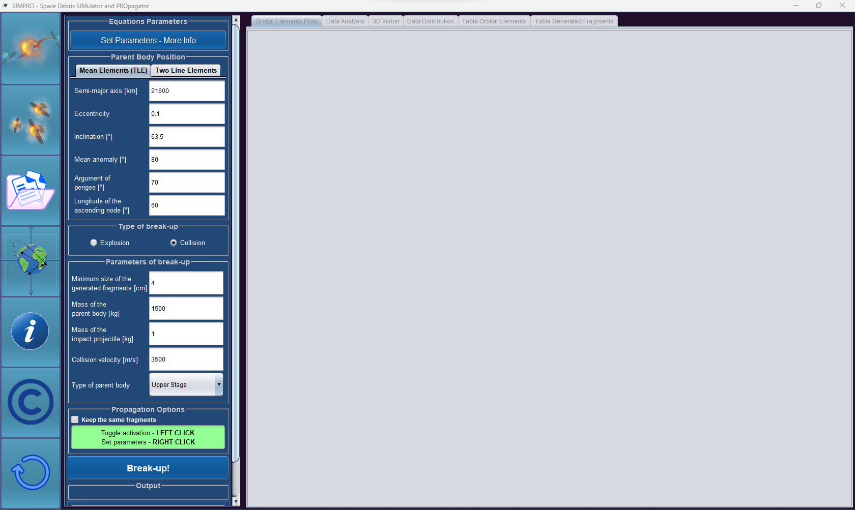
Evolution of the generated fragments:
Press LEFT click to turn on this option
Press RIGHT click to set up the propagation

Slide 10
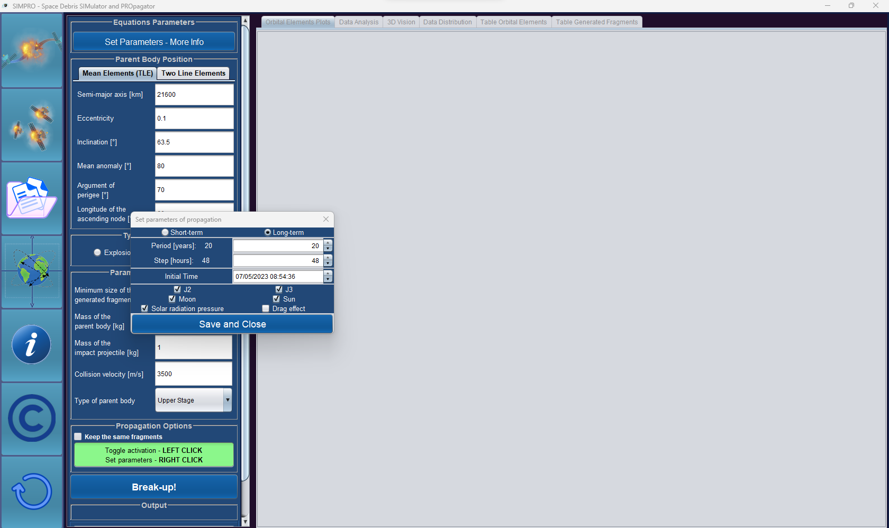
Hamiltonian framework:
Used to propagate the fragments for a long period
It uses the mean orbital elements
Periods is in years and step in hours

Slide 11

Cartesian framework:
Used to propagate the fragments for a short period
It uses the Cartesian state
Periods is in hours and step in minutes

Slide 12
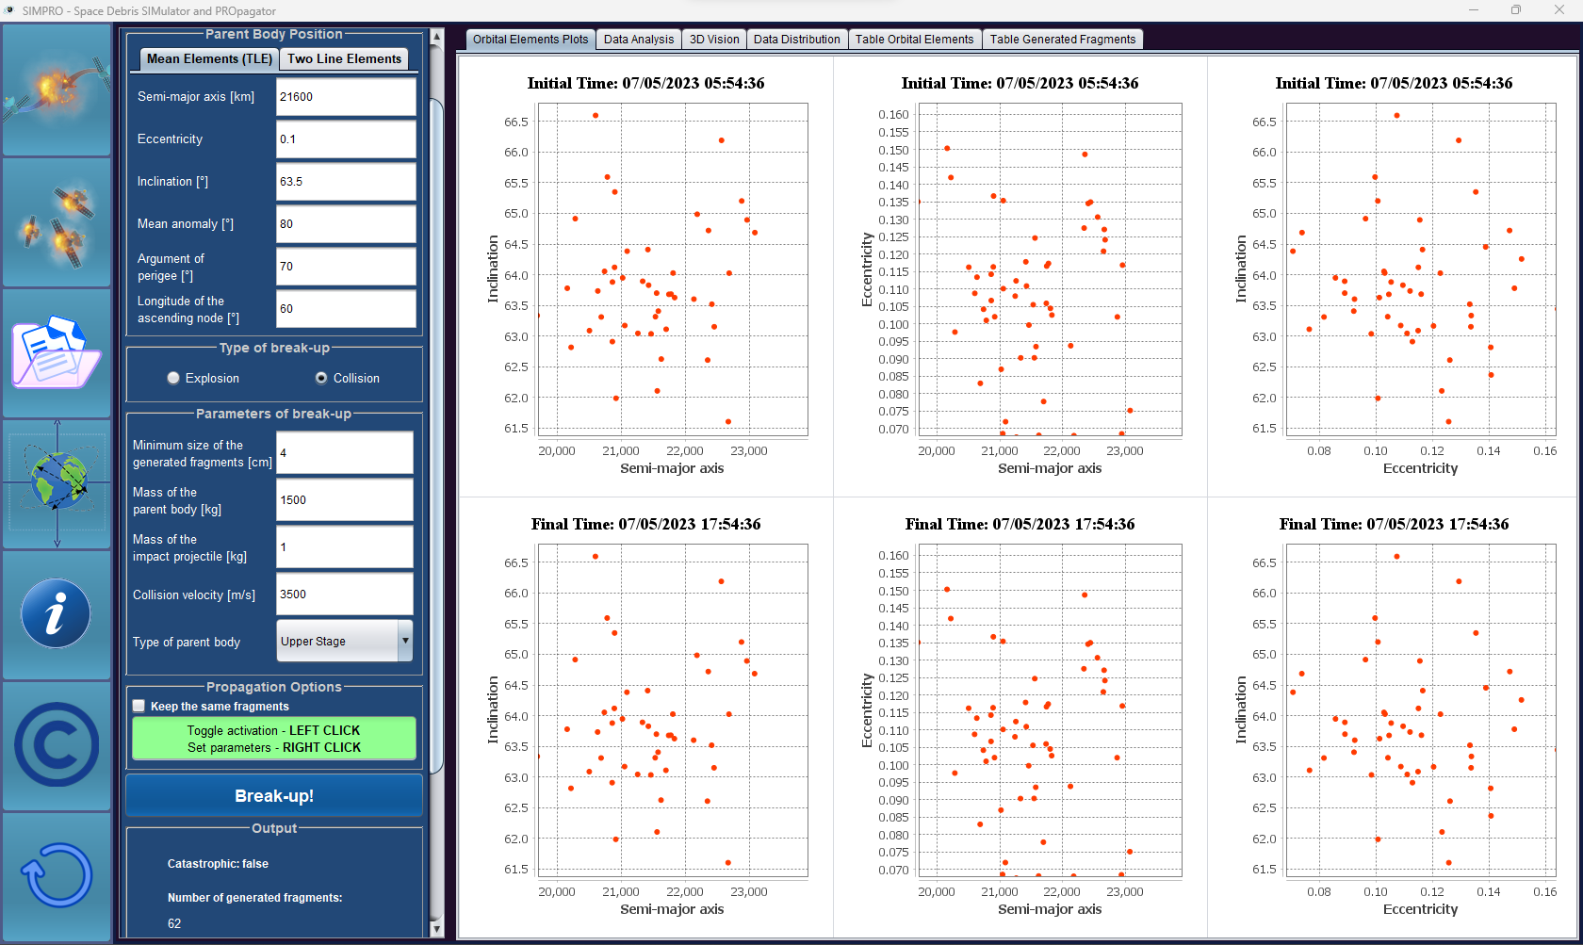
When evolution is selected, each panel is split in two parts: fragments after break-up and fragments after choosen period

Slide 13
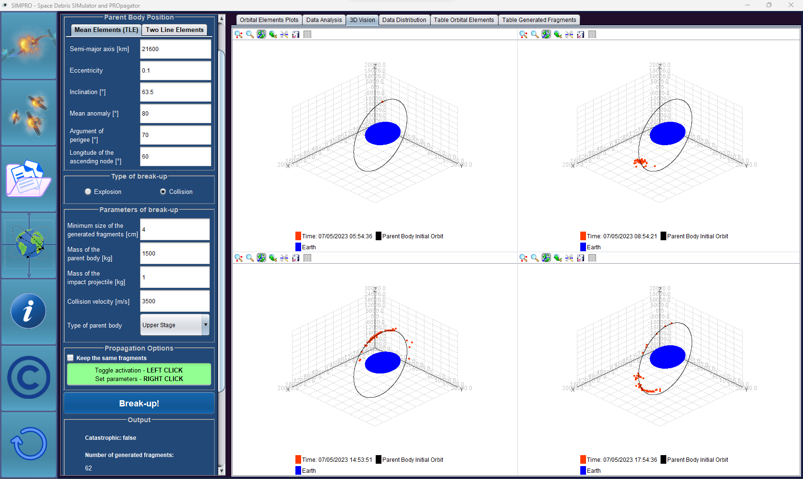
Panel containing 3-dimensional vision of the Cartesian position of the fragments
Legends: time of break-up, orbit of the parent body, and the shape of the Earth
T₀
T₀+T_{f}/4
T₀+3T_{f}/4
T₀+T_{f}

Slide 14
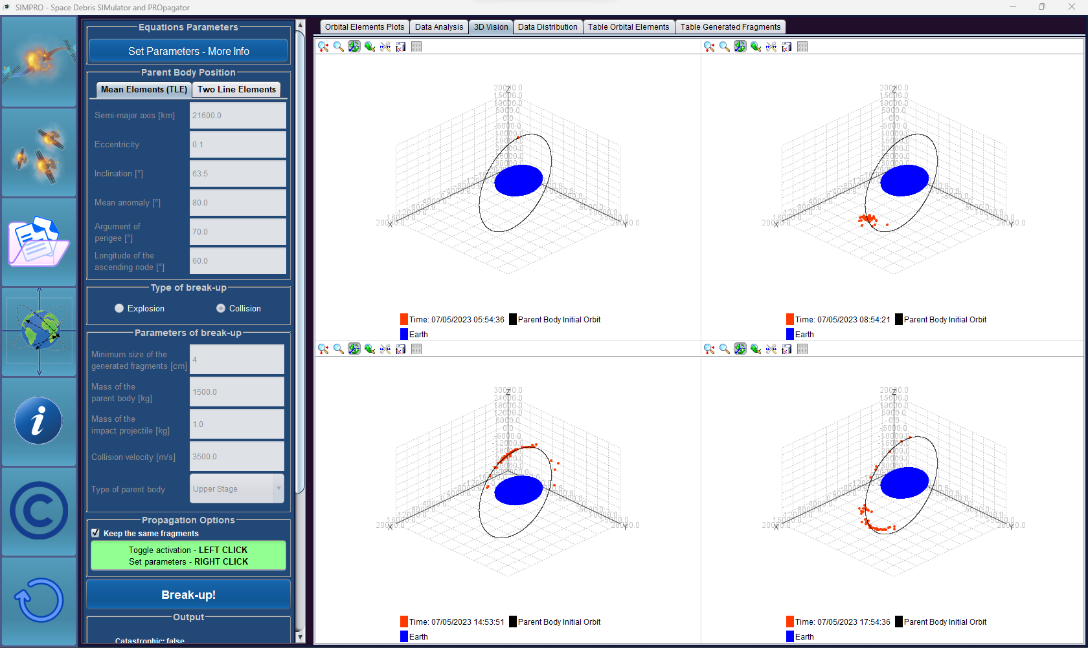
Lock the parameters of the last experiment
Select this flag to keep the generated fragments of the previous experiment

Slide 15
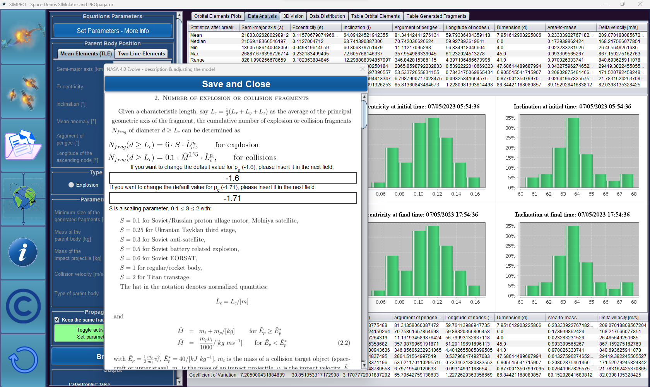
This panel allows users to change the default equations of NASA’s EVOLVE 4.0 model that describe the probabilistic model of A/m and delta velocity distributions
The panel contains the theory behind the fragmentation and editable fields

Slide 16
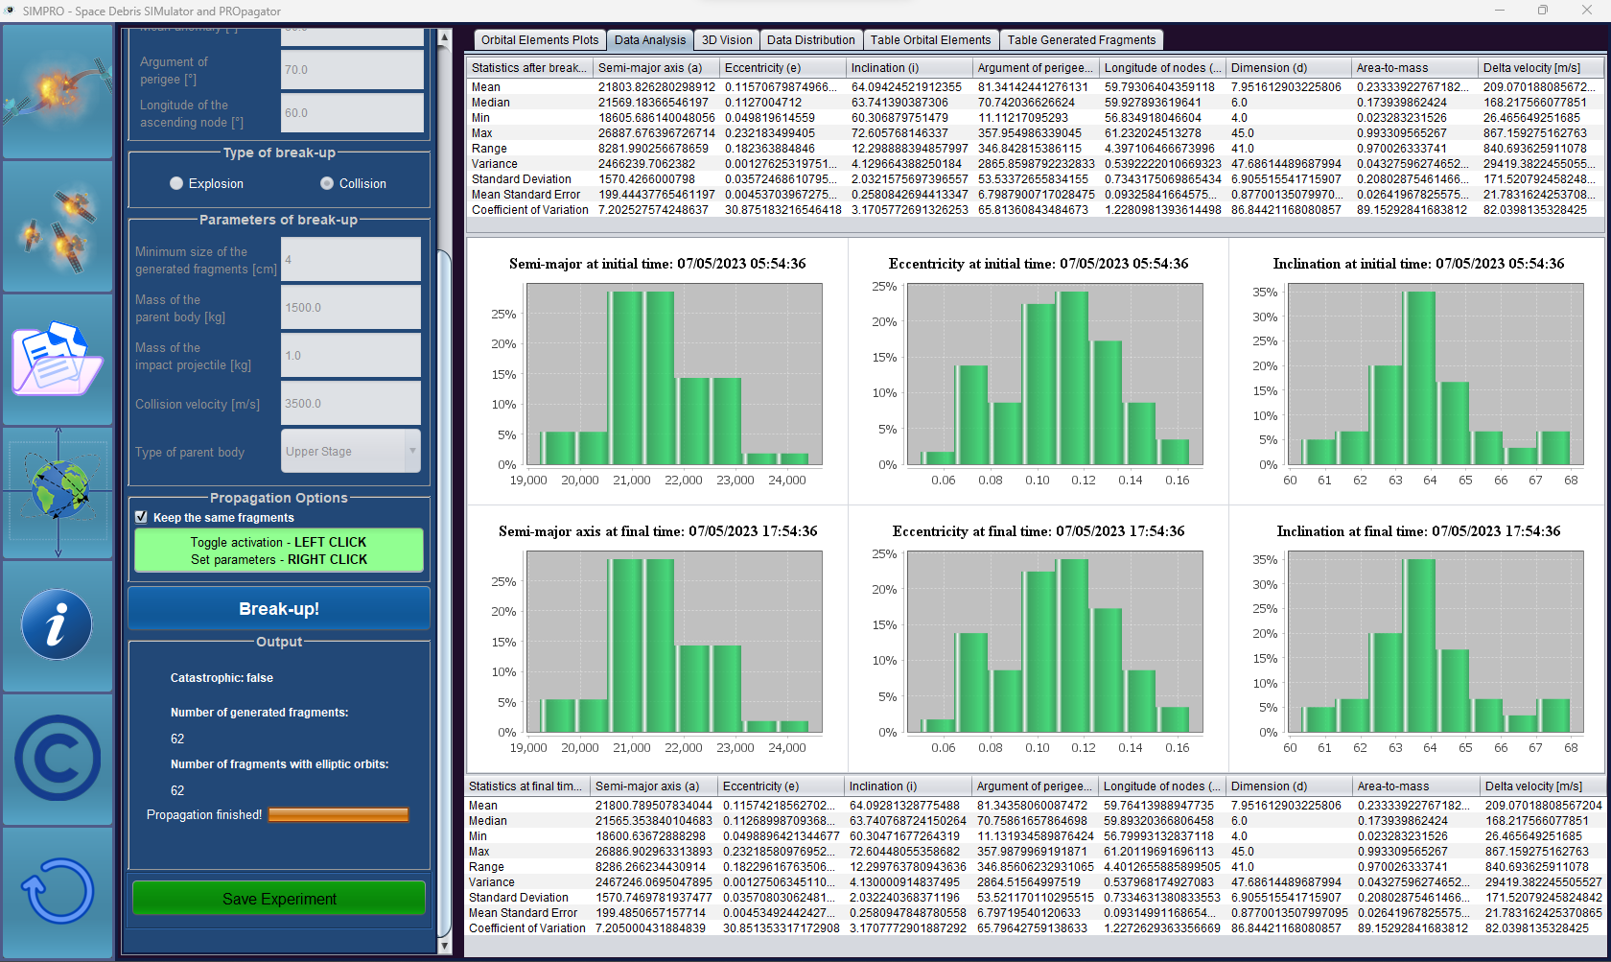
Press this button to save the current break-up

Slide 17
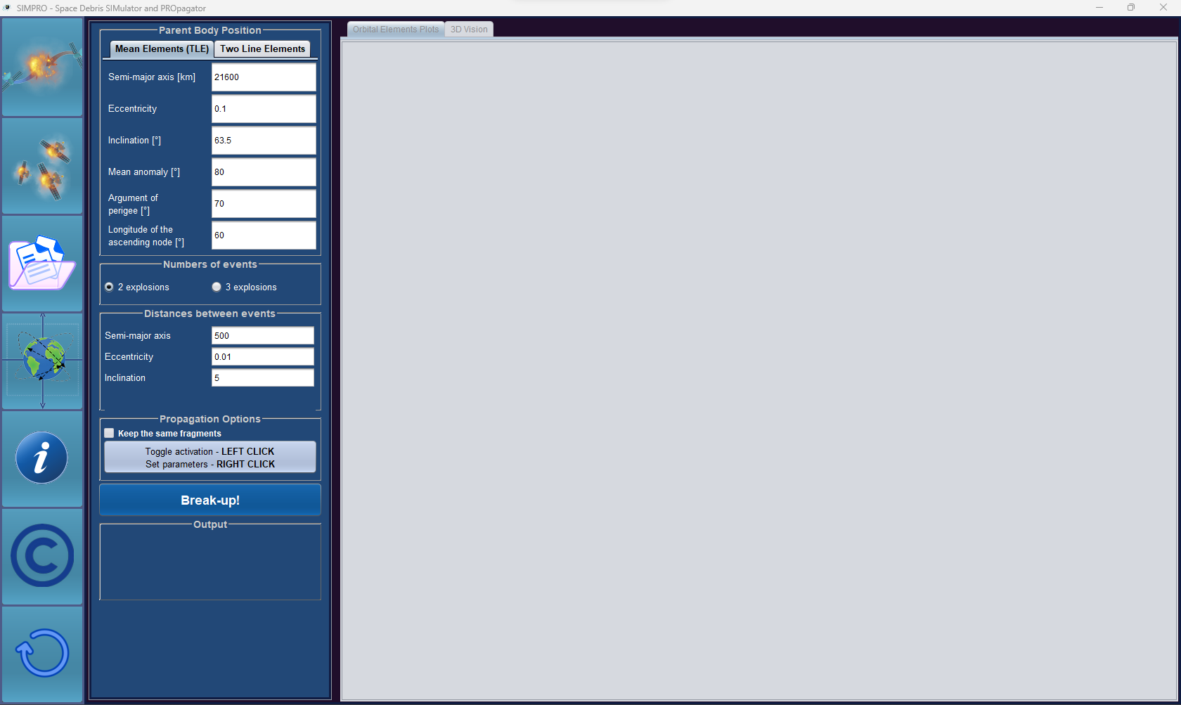
Orbital position of one break-up event
Number of break-up events
Distance between break-up events

Slide 18
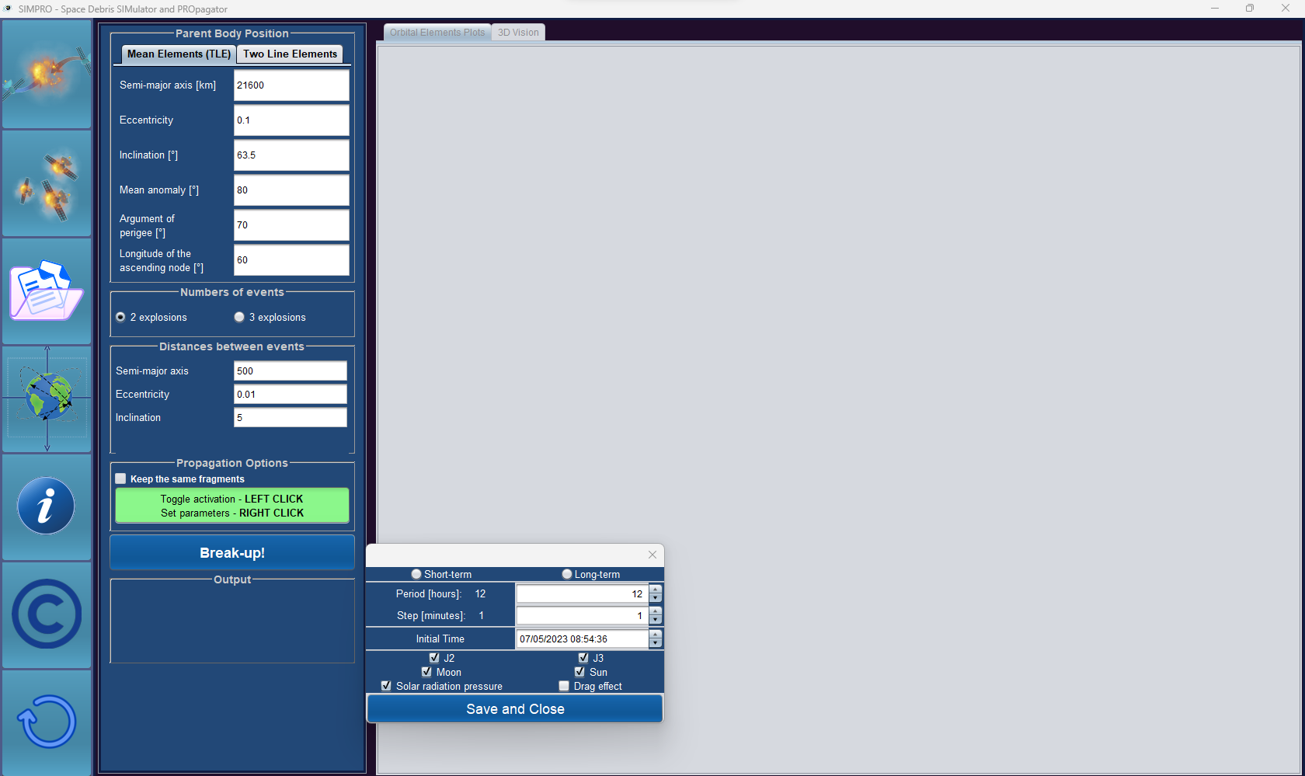
Option to propagate all fragments from all break-ups. Also the option to keep the same fragments of previous experiment
Parameters of the propagation

Slide 19
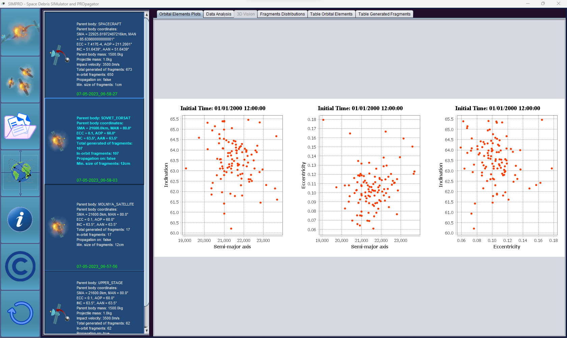
Each stored experiment shows the same panels as in a new break-up experiment (first page)
Choose a past experiment from the list. Details of the experiments are given inside the list

Slide 20
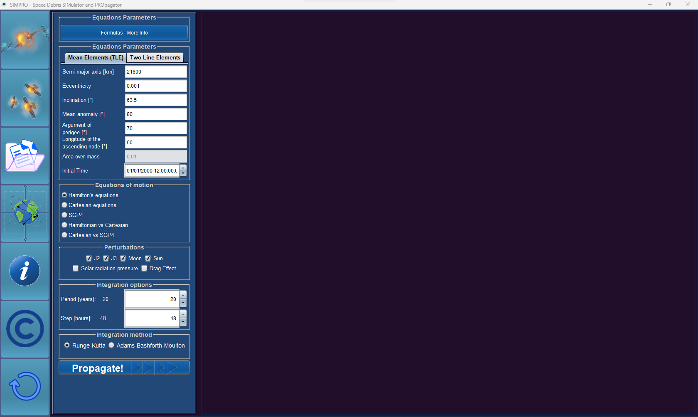
Initial conditions of the object, area-to-mass (in case SRP is selected), ballistic coefficient (in case Drag Effect is selected) and initial time of propagation (J200)
Choose forces acting on the object
Select the framework:
Hamiltonian – for long term propagation
Cartesian – for short term propagation
SGP4 – for short term propagation
Hamiltonian vs Cartesian – comparison
Cartesian vs SGP4 – comparison
Parameters of propagation:
Hamiltonian – Period in years; Step in hours
Cartesian – Period in days; Step in minutes
Integration method:
Runge-Kutta (4 steps)
Adams-Bashforth-Moulton (7-8 steps)
Choose the integration method

Slide 21
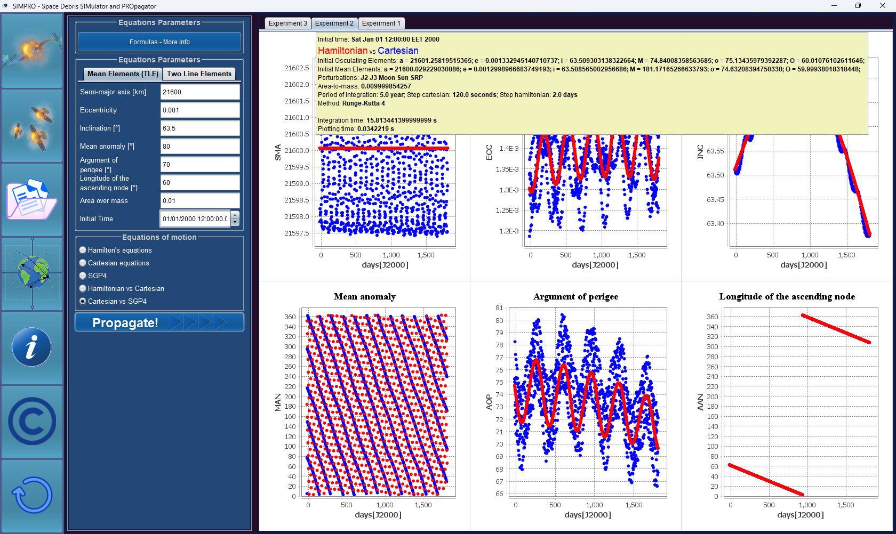
Store up to 10 past experiments
Information about the selected experiment (mouse hover)
Evolution of the orbital elements

Slide 22
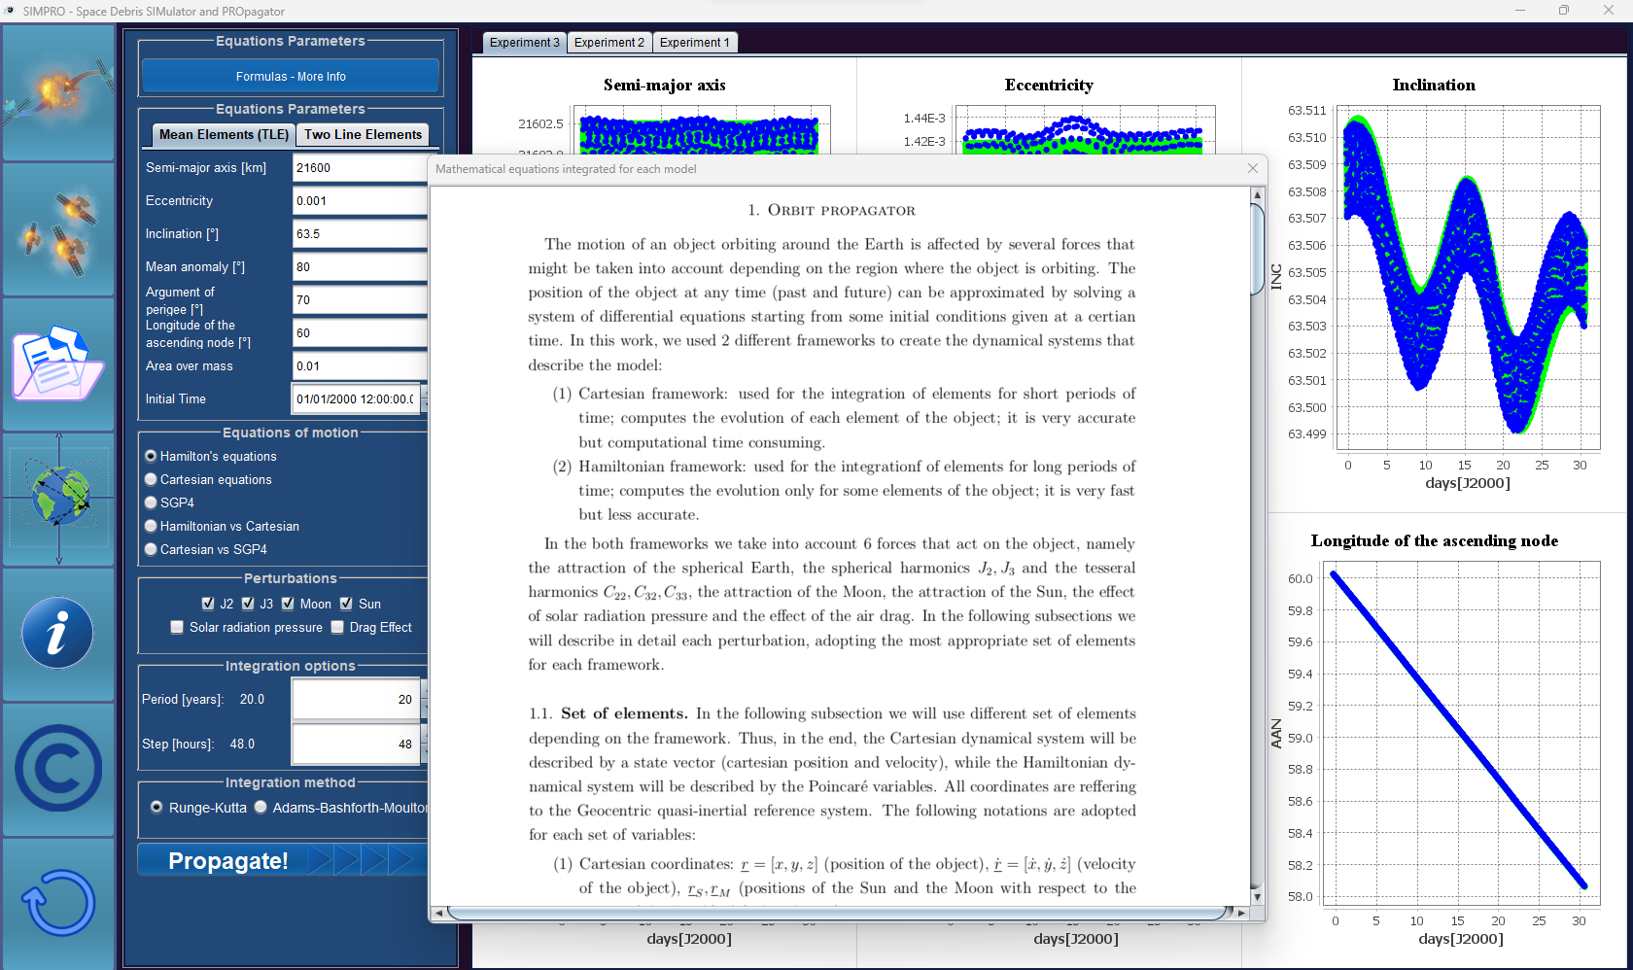
Theory behind the propagator Formulas + explanation

